Slide 1
Updates to CottonGen the cotton community database for basic, translational and applied research
Jing Yu¹, Sook Jung¹, Chun-Huai Cheng¹, Stephen Ficklin¹, Taein Lee¹, Ping Zheng¹, Don Jones², Richard Percy³, Dorrie Main¹
1. Washington State University, 2. Cotton Incorporated, 3. USDA-ARS
2014 ICGI Research Conference
Wuhan, China

Slide 2
About CottonGen
A community database to further enable basic, translational and applied cotton research.
Built using the open-source, user-friendly, Tripal database infrastructure used by several other databases
Consolidates and expands CottonDB and CMD to include transcriptome, genome sequence and breeding data, and data mining tools

Slide 3
CottonGen’s 1st Year Progress
Setting Queries
Web page development
Add Tools
CottonDB data in Chado
CottonGen
Released
Develop ICGI website
Tripal instance created
CottonDB on WSU servers

Slide 4
CottonGen’s 2nd Year
New Features and New Data
China & UZ germplasm evaluations
ARS digital images
New SSR and SNP markers
Data download, submission, FAQ,
Tutorials
Trait, QTL, Publication searches
CottonGen published in Nucl. Acids Res.
ICGI election system & website
D5 genome assemblies & annotations

Slide 5
CottonGen’s 3rd Year …
New Tools and WGS data
Implement
genome synteny browser
WGS &
GMAP data
JBrowse
50k new SSRs and 150k new SNPs
Getting into the Whole Genome Era
CottonCyc
& JGI-D5
pathways
SSR marker redundancy & sequence clearification

Slide 6
Major Content
Over 265k genetic markers consisting of 3,541 RFLPs, 78,340 SSRs, 183,035 SNPs
15,117 germplasm records including 97 populations and 15,020 individual entries
Over 108k trait and QTL scores
12,269 digital images of 2,016 germplasm, from USDA-ARS

Slide 7
Major Content (cont.)
245k of Genes and Unigenes
G. raimondii genome (BGI and JGI), and G. arboreum genome (BGI)
Metabolic Pathways built by JGI-D5 annotation v2.1 data
15,155 references from journal articles, conference proceedings, patents, book chapters, and theses.

Slide 8
Major Tools
CMap - Comparison of various maps
GBrowse - Generic Genome Browser
JBrowse - Java based genome browser. Very fast and scales well to large datasets such as RNASeq and GBS
CottonCyc - Metabolic Pathways in Cotton
BLAST - Basic Local Alignment Search Tool

Slide 9
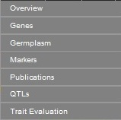
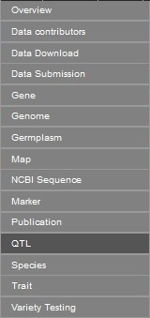
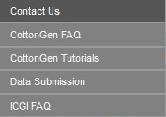
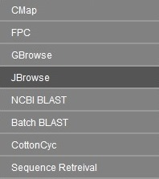
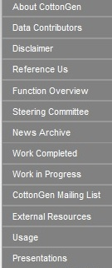
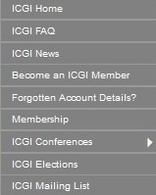
http://www.cottongen.org/

Slide 10
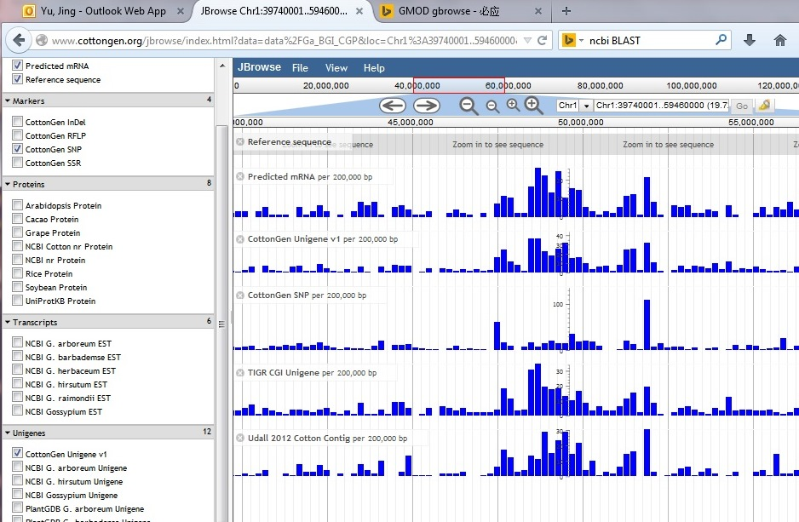
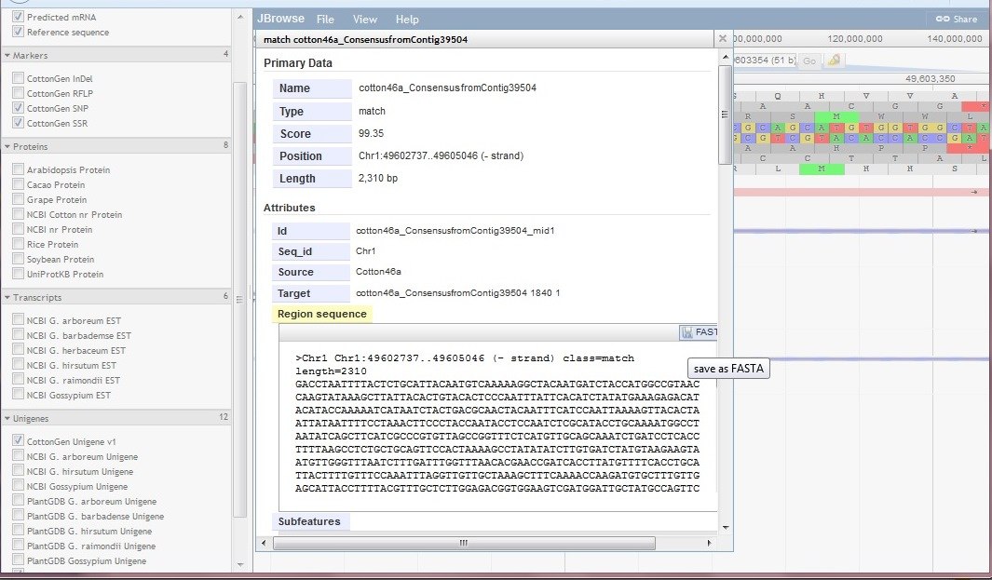
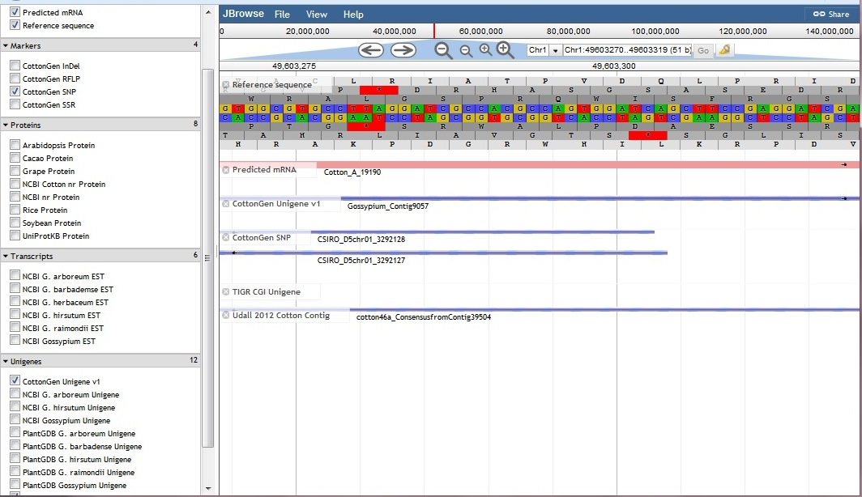
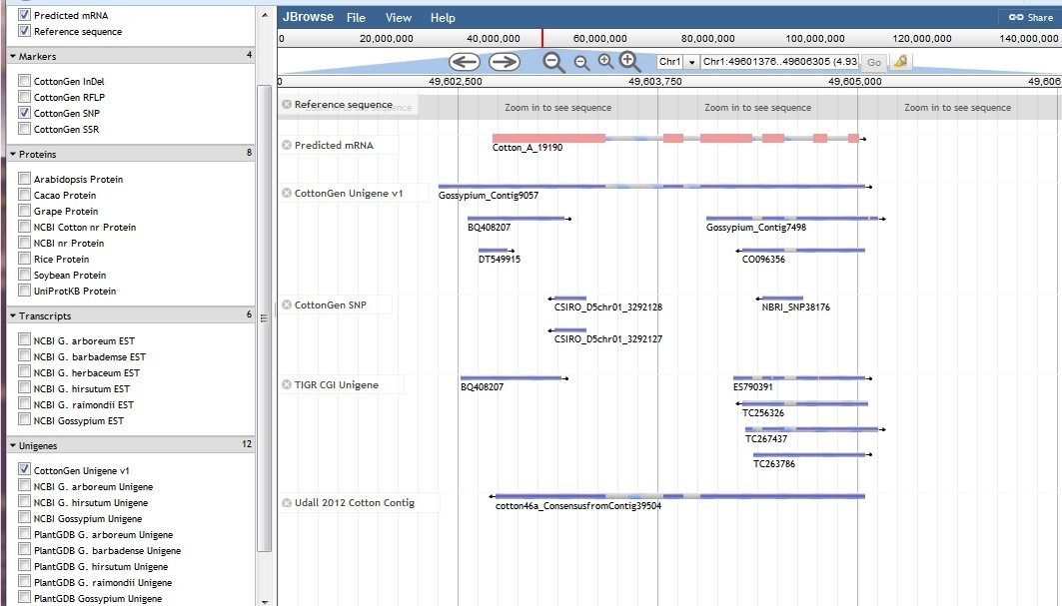
CottonGen JBrowse

Slide 11
CottonCyc Current
Motablic pathways for JGI v2.0 G. raimondii (D5) genome assembly
CottonCyc JGI-D5 summary:
Pathways: | 382
Enzymatic Reactions: | 2044
Transport Reactions: | 13
Polypeptides: | 77269
Enzymes: | 12468
Transporters: | 262
Compounds: | 1473

Slide 12
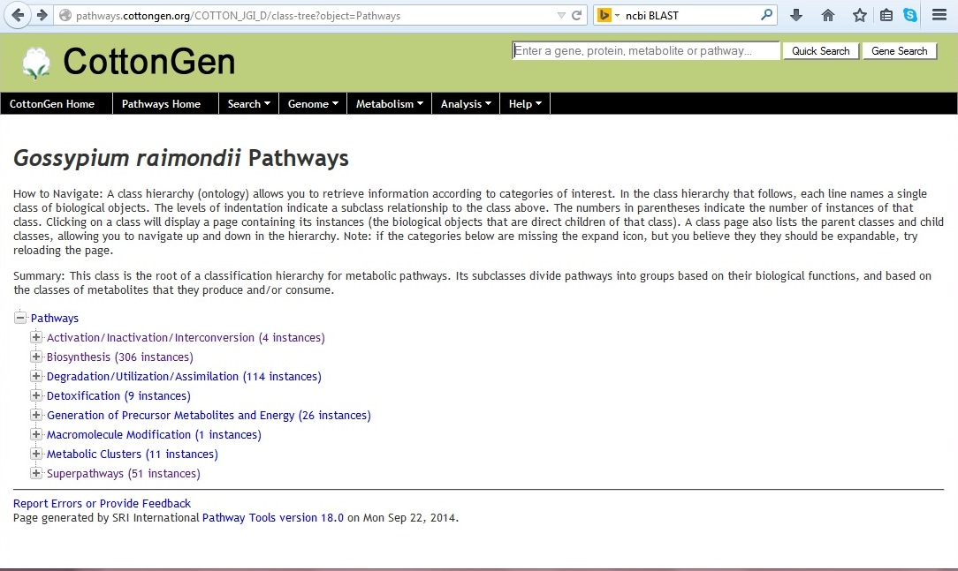
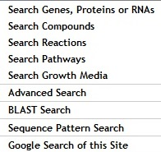
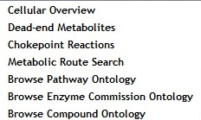
CottonCyc

Slide 13
CottonCyc - Pathway

Slide 14
CottonCyc – cellular overview

Slide 15
Future Work
Implement GBrowse-Syn, a GBrowse-based synteny browser.
Implement more tools for genome annotation and breeder communities.
Germplasm evaluation data from ARS College Station, TX
Add US National Variety Trials data and make fully searchable
More QTL and QTL mapping data

Slide 16
Acknowledgements
Industry Funding
Cotton Incorporated, Bayer CropScience, Dow/Phytogen, Monsanto, Association of Agricultural Experiment Station Directors
Government Funding
USDA ARS
USDA NIFA AFRI and SCRI programs (funding Mainlab Tripal and GenSAS Development)
University Support
Washington State University, Texas A&M, Clemson University
Community of Cotton Researchers

Slide 17
Thanks for your attention Questions?

