Slide 1

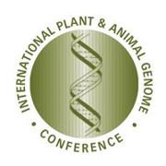


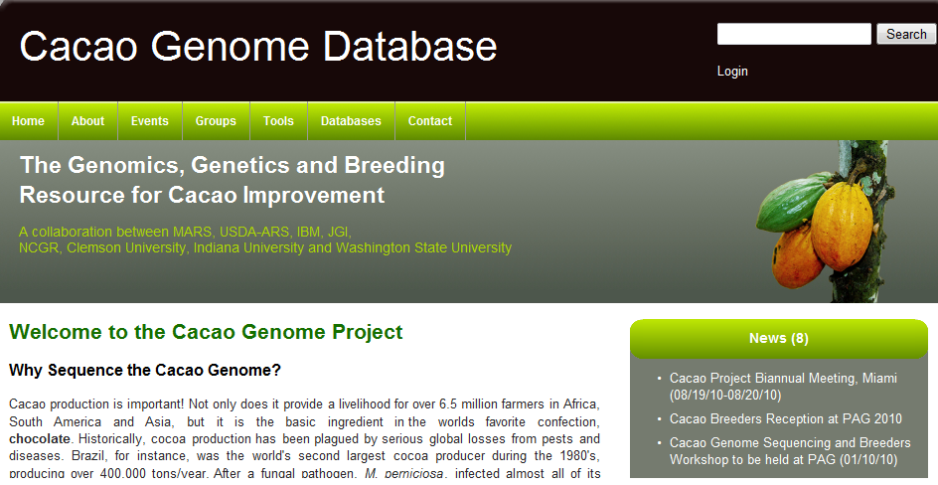

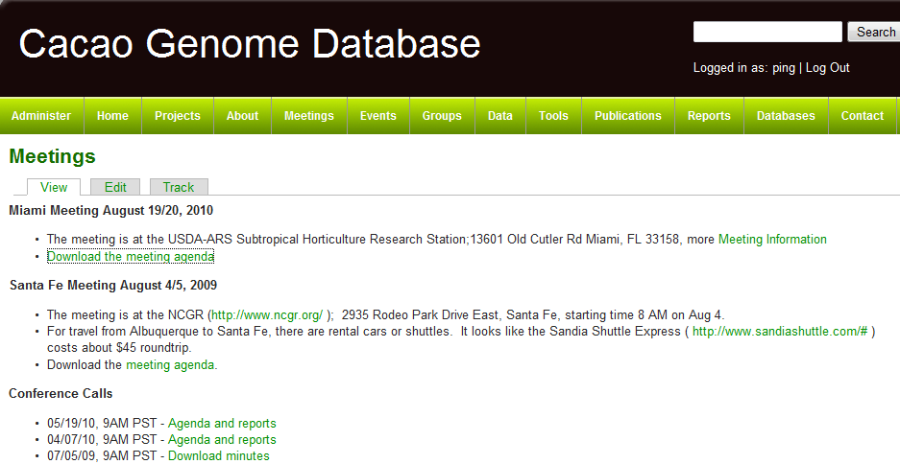

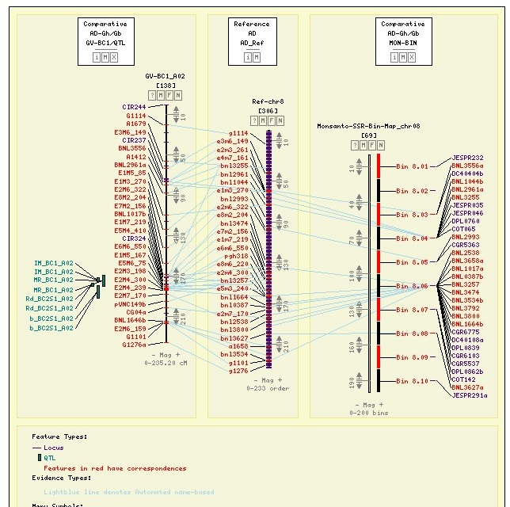
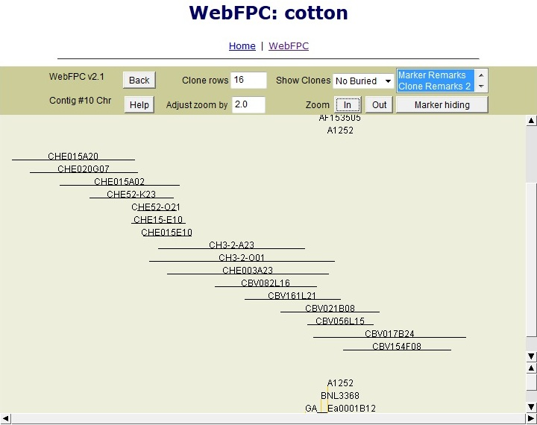
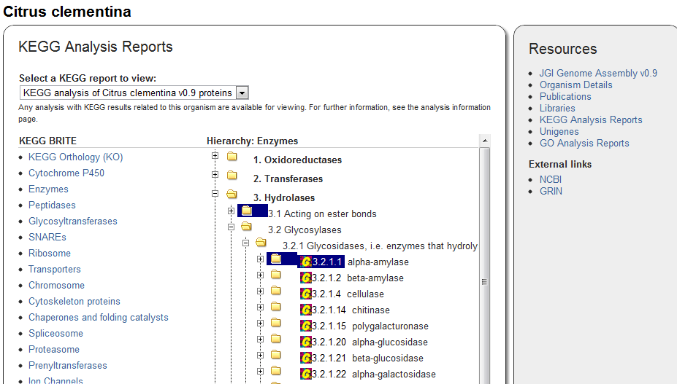
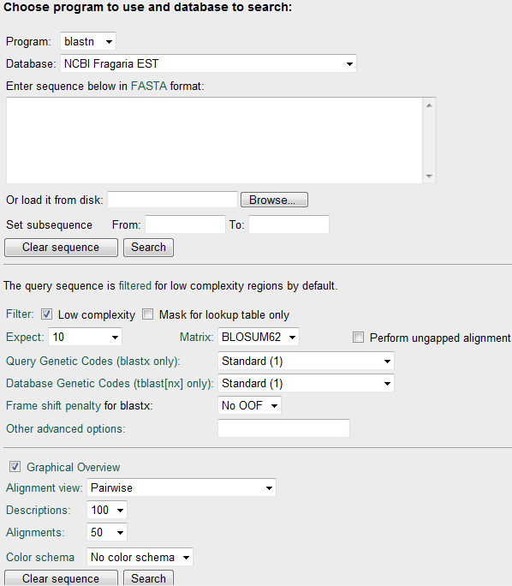
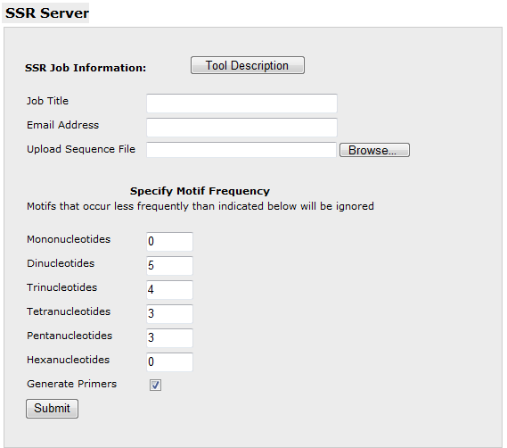
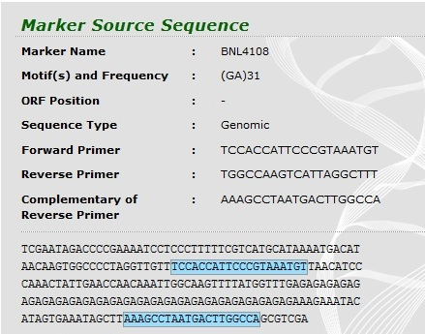
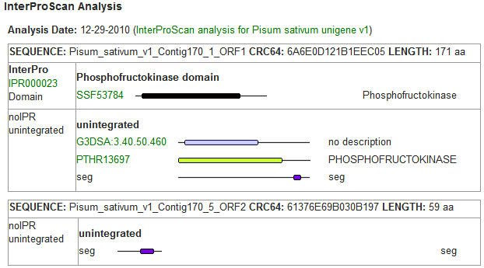
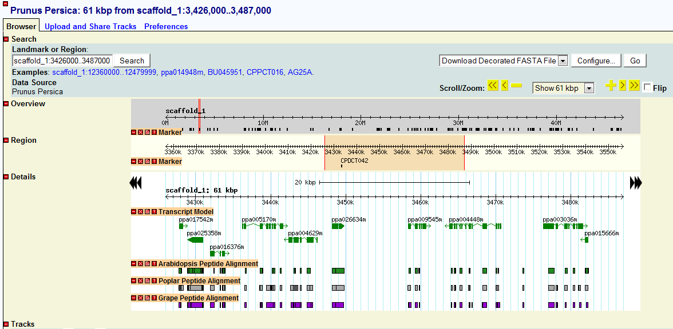
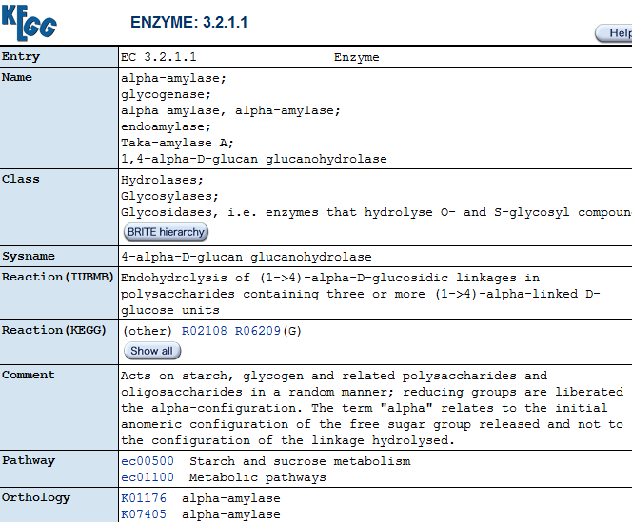
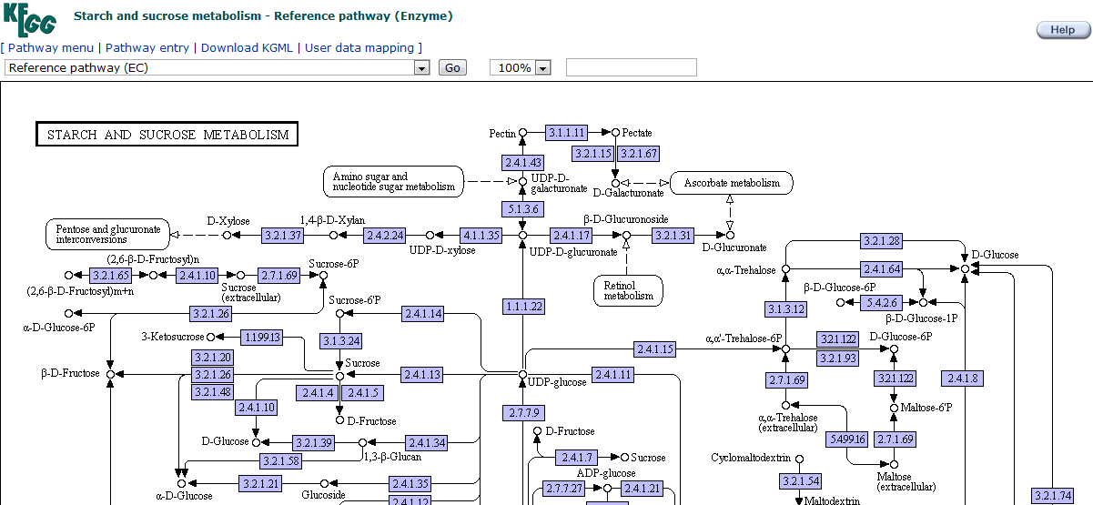
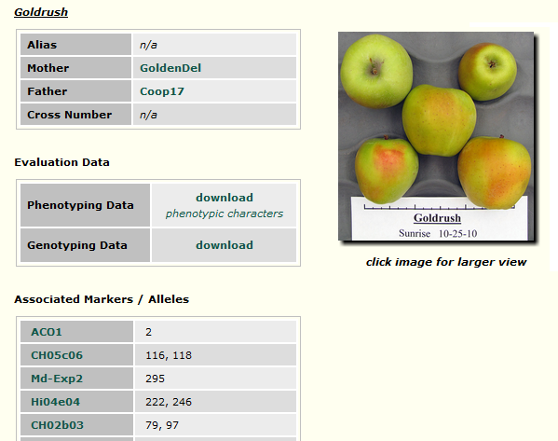
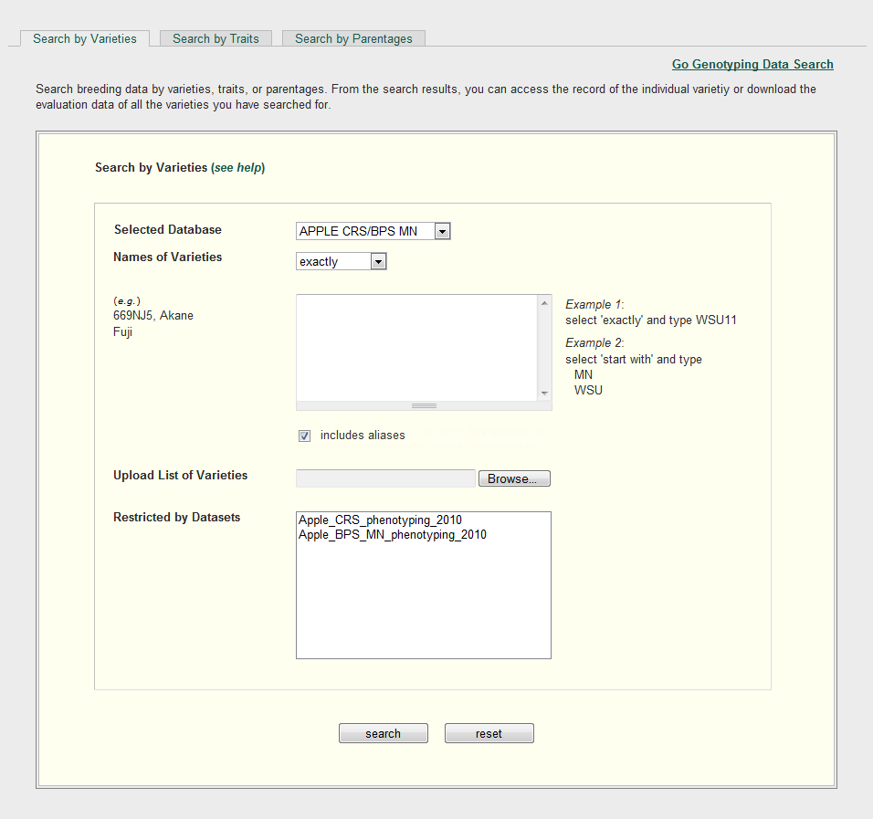
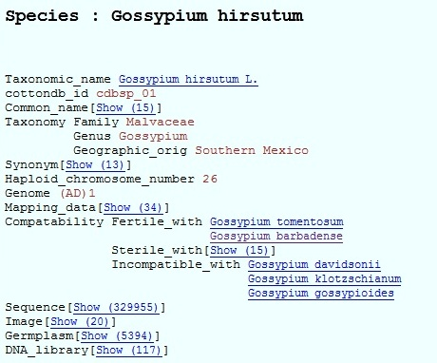
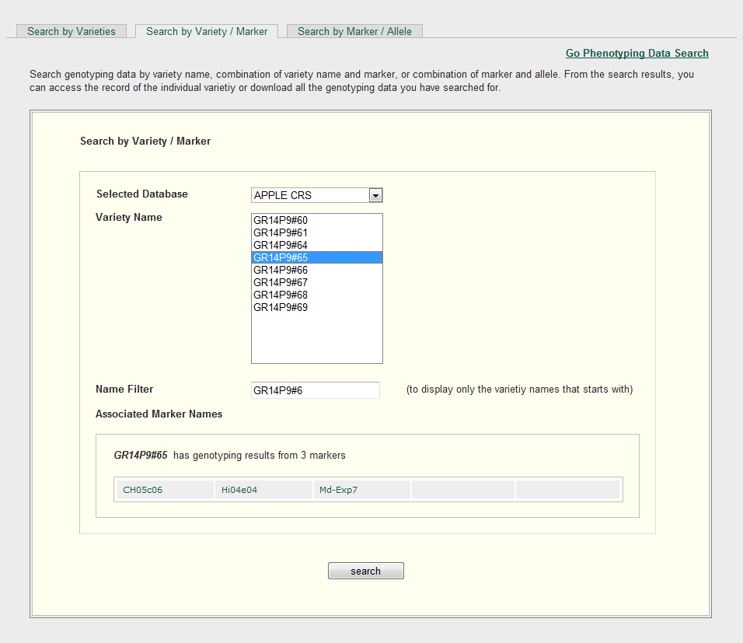
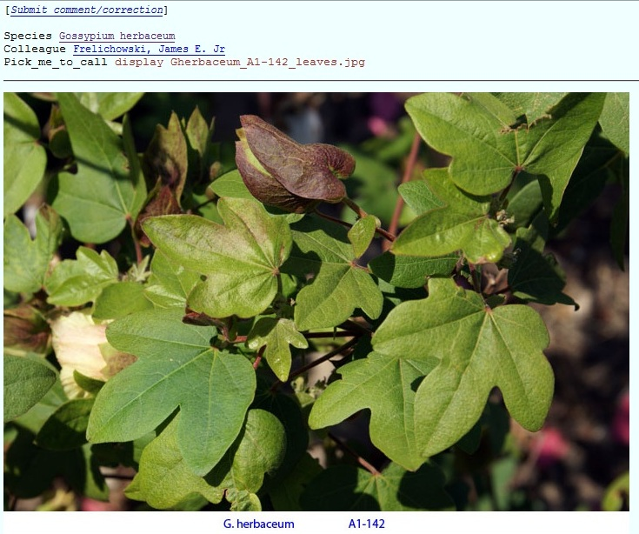
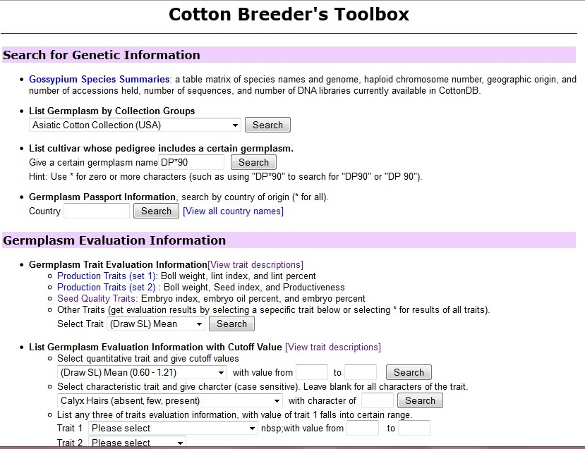
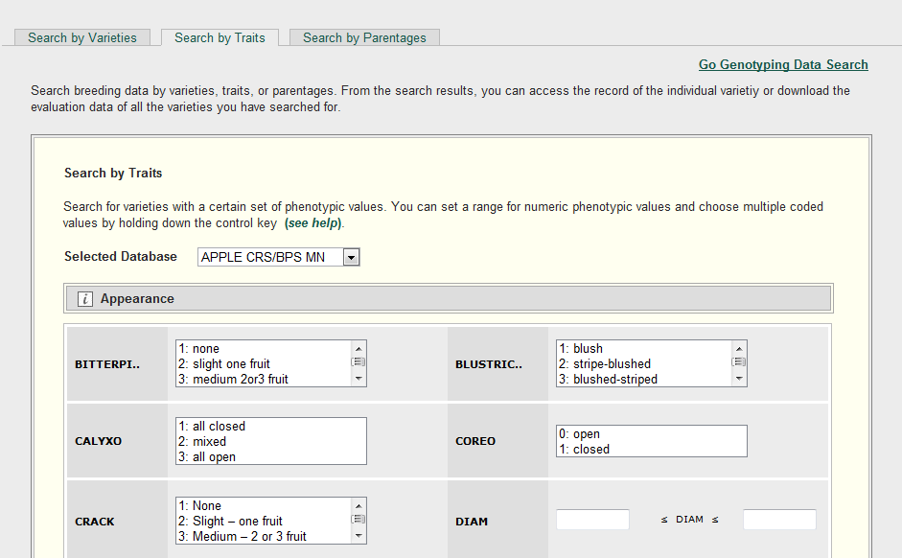
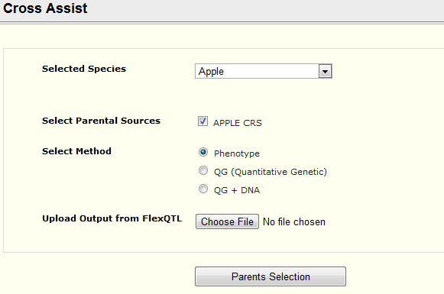
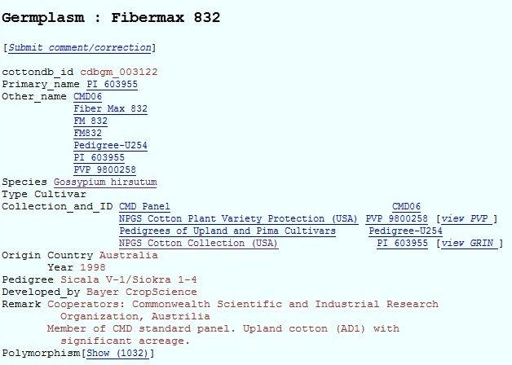
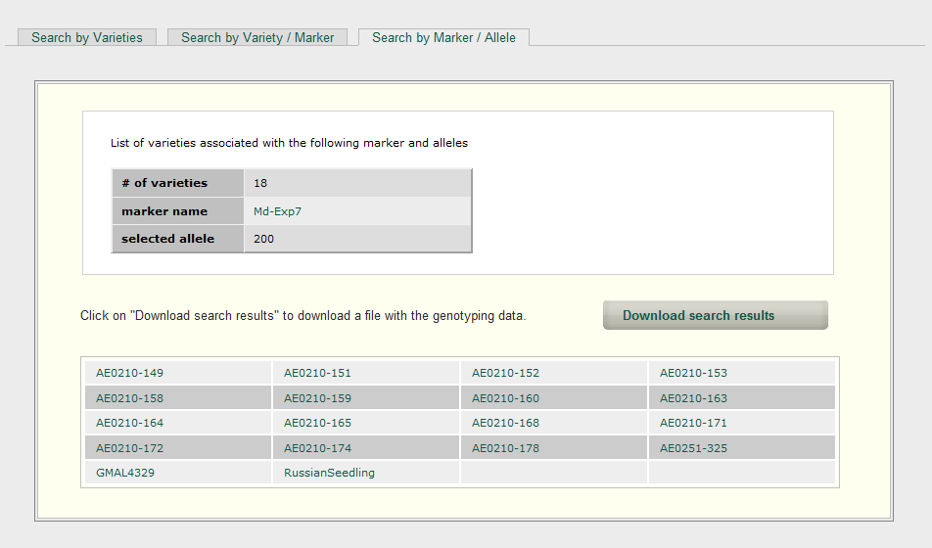
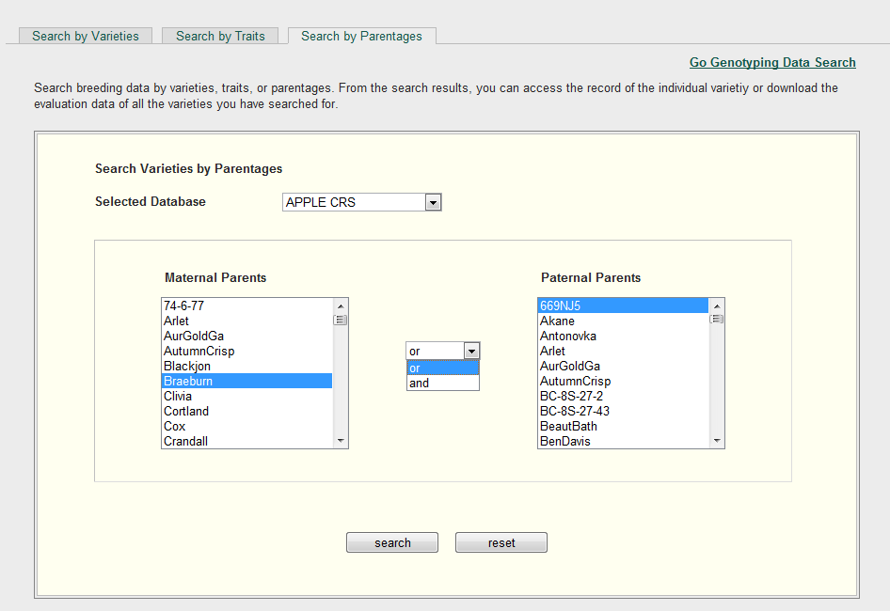








CottonGen: Developing an Integrated Genomics,
Genetics and Breeding Database for Cotton Research
Plant and Animal Genome Conference XX
Jing Yu¹, Sook Jung¹, Stephen Ficklin¹, Chun-Huai Cheng¹, Taein Lee¹, Ping Zheng¹, Don Jones², Richard Percy³, Dorrie Main¹
1. Washington State University 2. Cotton Incorporated 3. USDA-ARS
Abstract
A new cotton community database (CottonGen, htpp://www.cottongen.org) is being developed to further enable cotton genomics, genetics and breeding research. CottonGen is being built using the open-source Tripal database infrastructure developed for the genome databases hosted at Washington State University (www.bioinfo.wsu.edu). CottonGen will initially consolidate the data from CottonDB and the Cotton Marker Database (CMD), which includes sequences, genetic and physical maps, genotypic and phenotypic markers and polymorphisms, QTLs, pathogens, germplasm collections and trait evaluations, pedigrees, and relevant bibliographic citations. CottonGen will be expanded to include annotated transcriptome, genome sequence, marker-trait-locus and breeding data, as well as enhanced tools for easy querying and visualizing research data. Examples of the functionality being developed for CottonGen are presented through examples of our existing Tripal databases.
Goal:
To provide a centralized, user-friendly, web portal for access to integrated cotton genomic, genetic and breeding data and tools, enabling basic, translational and applied research for the cotton community.
Objectives:
Build an efficient, modular database through implementation of the
open-source Tripal database infrastructure.
Integrate annotated transcriptome and genome sequence
data.
Consolidate CottonDB and CMD in CottonGen
Build a toolbox where breeders can access tools to analyze
integrated genotype, phenotype, and pedigree data
Implement enhanced tools for easy querying and data visualization
Building an Efficient Database
Housing both Public and Private Data
Content Management System
Easy to Use and Update
Open Source
Popular, Powerful, Robust and Secure
Modular and Extensible
Users/Roles/Access Control
Public site
Private site
Drupal modules as web front-end for Chado
Example from the Cacao Genome Database
Map Comparisions in CMAP
Chado
Generic Database schema
Relational Database Schema
Sophisticated Schema for Molecular Biology
Do Complex Representations
More Tools (Rosaceae and Citrus)
Maps, Markers and FPC data of CottonDB and CMD will be merged in CottonGen
Markers
Genome Sequences in GBrowse (GDR)
Annotated cotton genome sequences will be hosted in CottonGen, will include genes, transcripts, SSRs, SNPs, and primers, etc.
CottonDB taxonomy data
will be added to CottonGen
The Breeders Toolbox will be enhanced
to include more searching and analysis
features (GDR example on right)
Acknowledged
with thanks
The Cotton
Research
Community

