Slide 1
New Data and Functionality in CottonGen
Jing Yu, Sook Jung, Chun-Huai Cheng, Stephen Ficklin, Ping Zheng, Taein Lee, Richard Percy, Don Jones, Dorrie Main
2014 Beltwide Cotton Conference
January, 2014
New Orleans, Louisiana

Slide 2
Topics
Introduction
About CottonGen
Major Achievements
Demo of CottonGen
Database Overview & What’s New
Query Examples
Future Work

Slide 3
About CottonGen
A community database to further enable basic, translational and applied cotton research.
Built using the open-source, user-friendly, Tripal database infrastructure used by several other databases
Consolidates and expand CottonDB and CMD to include transcriptome, genome sequence and breeding data, and data mining tools

Slide 4
CottonGen’s First Year Progress
Setting Queries
Web page development
Add Tools
CottonDB data in Chado
CottonGen v0.9
Released
Develop ICGI website
Tripal instance created
CottonDB on WSU servers

Slide 5
CottonGen’s Second Year
<New Features and New Data>
China & UZ germplasm evaluations
ARS digital images
New SSR and SNP markers
Data download, submission, FAQ,
Tutorials
Trait, QTL, Publication searches
CottonGen published in Nucl. Acids Res.
ICGI election system & website
D5 genome assemblies & annotations

Slide 6
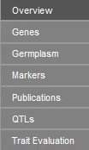
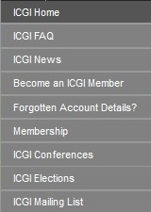
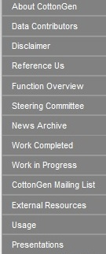
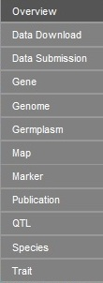
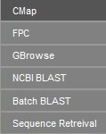
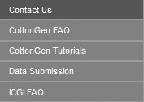
http://www.cottongen.org/

Slide 7
Major Data
Markers - 27,200 genetic markers (4,200 new)
Maps - 49 maps with over 34,559 loci
QTLs – 988 QTLs for 25 traits (684)
Polymorphism - 2,264 polymorphic SSRs
Germplasm - Nearly 15,117 germplasm records (504)
Traits - 107,889 trait scores for 57 traits (44,593)
Images – 12,269 images of 2,016 germplasm
Sequences - 610,246 sequence records (60,246)
References - Over 13,000 references (1,269)
CottonGen Gossypium Unigene v1.0 (09/16/12)
G. raimondii (D5) genome – BGI & JGI versions

Slide 8
Tools with Data
CMap - Currently has 49 maps with 34,559 loci
GBrowse - G. raimondii (BGI & JGI versions)
FPC – TM-1 contigs from USDA-ARS/TAMU
BLAST Servers - UniProt and nr Proteins, BGI D-genome sequences, db_ests, unigenes, and CottonGen markers (2013-11 updates)
Sequence Retrieval - To retrieve sequences in FASTA format

Slide 9
Data Search Enhancement
QTL Search - Search can start from either trait name or published symbol or CottonGen QTL label
Advanced Marker Search - Search markers in either a combination of type, species, and mapped species
Publication Search - New search site
Germplasm ‘Search by Name’ - Germplasm name or alias can be searched and wild card ‘*’ can be used in search.
Trait Evaluation Search - Search result display table can be resorted by trait names.

Slide 10
CottonGen Search Examples
Sample Question 1:
I am interested in the pollen color
gene ‘P1’ and would like to find all
the markers mapped within 20cM
of this gene.

Slide 11
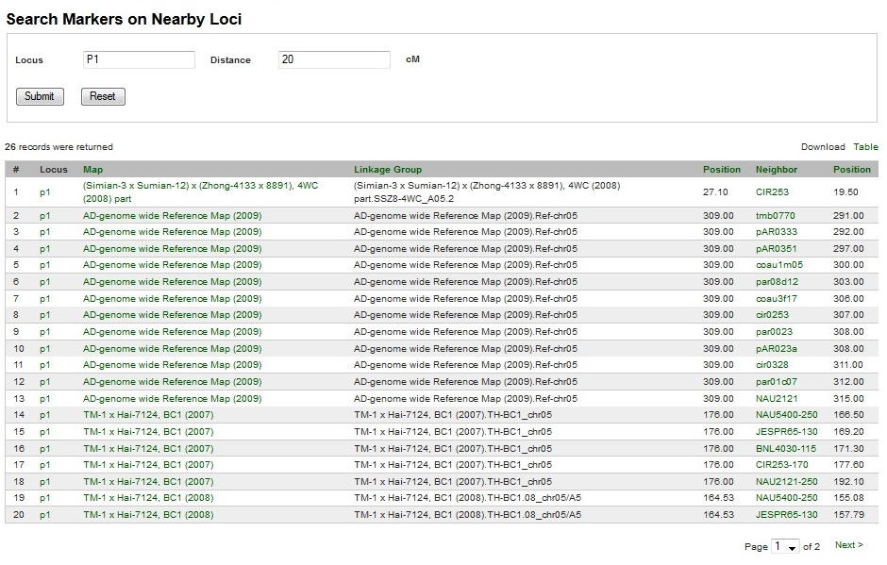
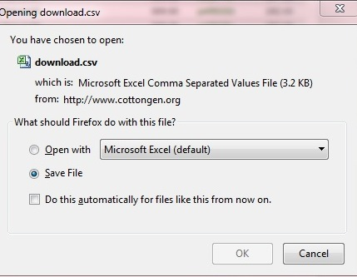
Marker Search: Near by Loci
From Navigation Bar, click “Search”, then select “Markers”
From new window, select “Search Markers on Nearby Loci”

Slide 12
CottonGen Search Examples
Sample Question 2:
I am interested in any traits related
to ‘fiber’. I want to know their
mapping information.

Slide 13
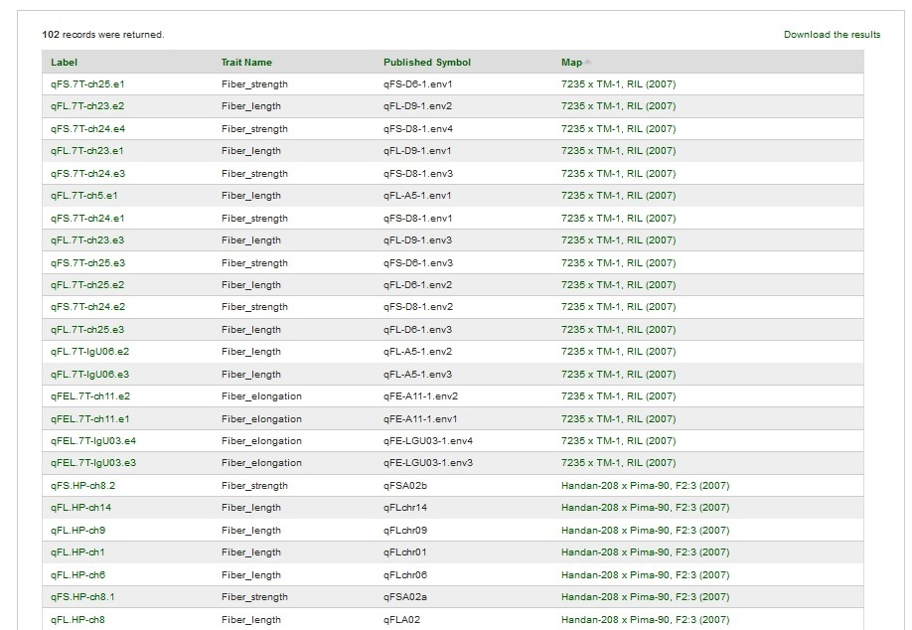
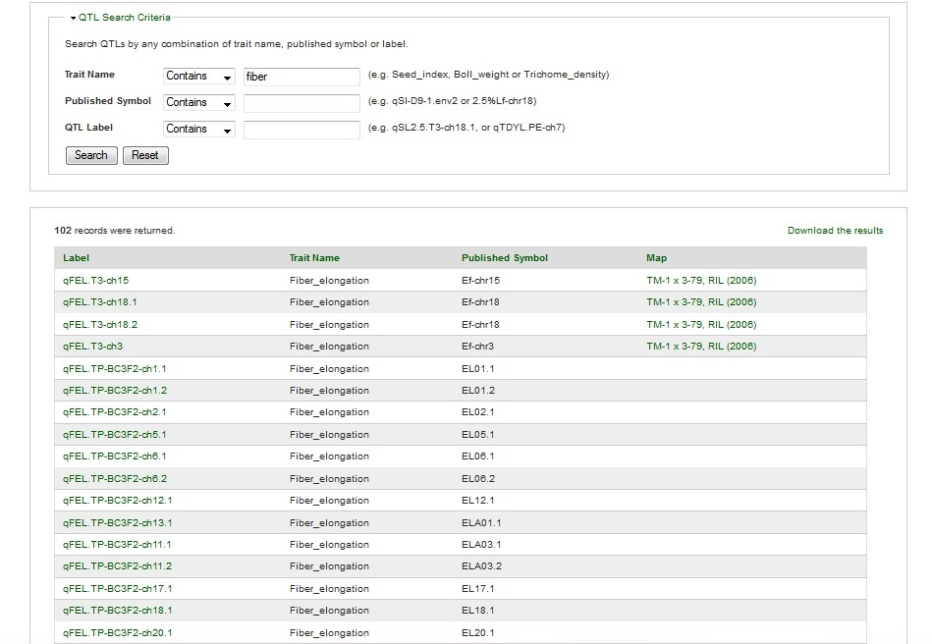
QTL Search

Slide 14
CottonGen Search Examples
Sample Question 3:
I would like to select parents with
a) 2.5% span length >= 1.2
b) Micronaire between 4-4.5
c) maximum genetic diversity

Slide 15
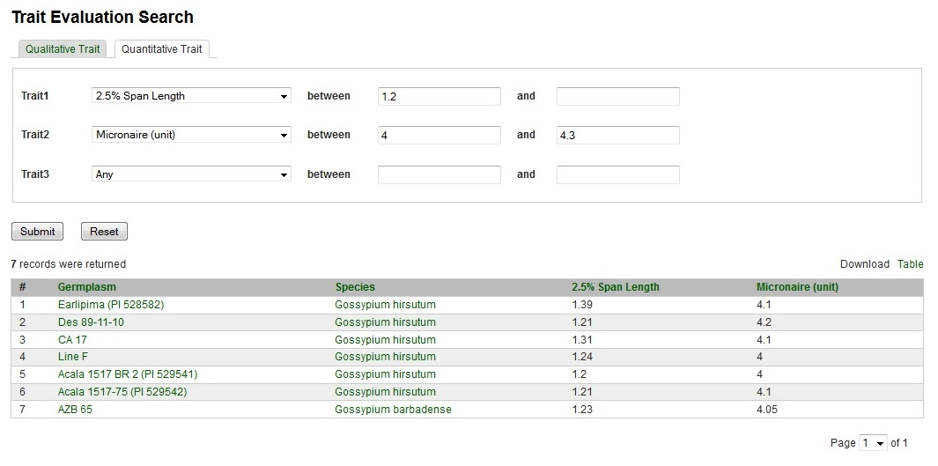
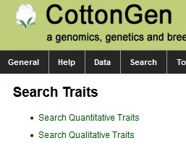
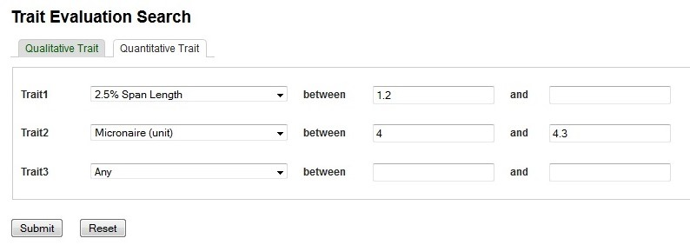
Sample 3 Search Steps
From Navigation Bar, click “Search”, then select “Trait Evaluation”
From new window, select “Quantitative Traits”
3. Select “2.5% Span Length”, set minimum value =1.2
4. Select “Micronaire” , set value between 4 and 4.3, then “Submit” query
Search criteria:
2.5% span length >= 1.2
Mirconaire btw 4 - 4.3

Slide 16
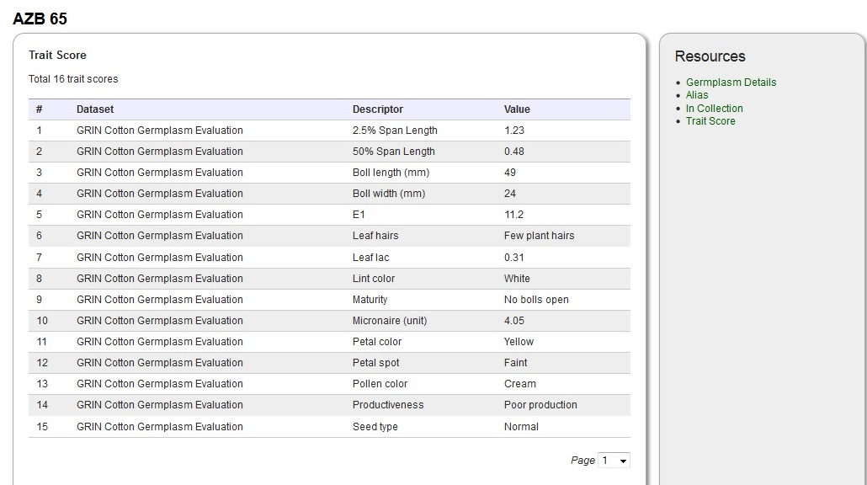
Find out more information from links

Slide 17
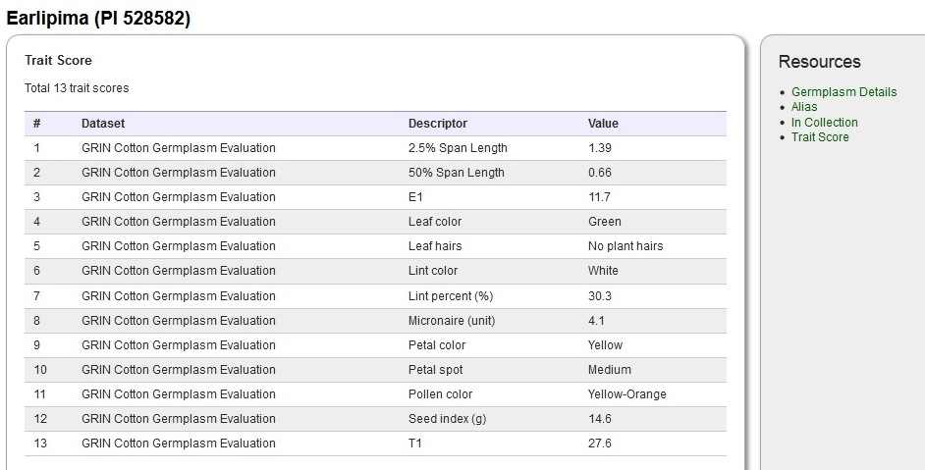
Find out more information from links

Slide 18
CottonGen Search Example 4
Sample Question 4:
Find all germplasm with
Deltapine 90 in their pedigree

Slide 19
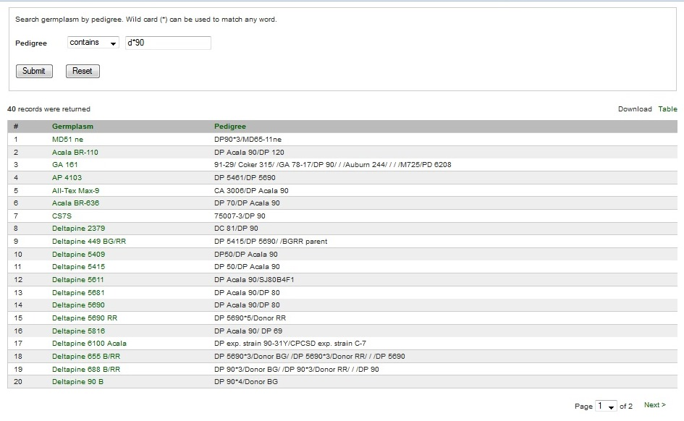
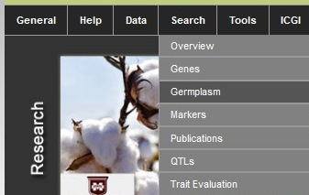
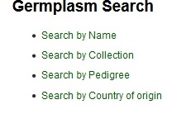
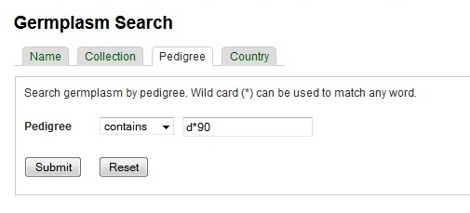
Sample 4 Search Steps

Slide 20
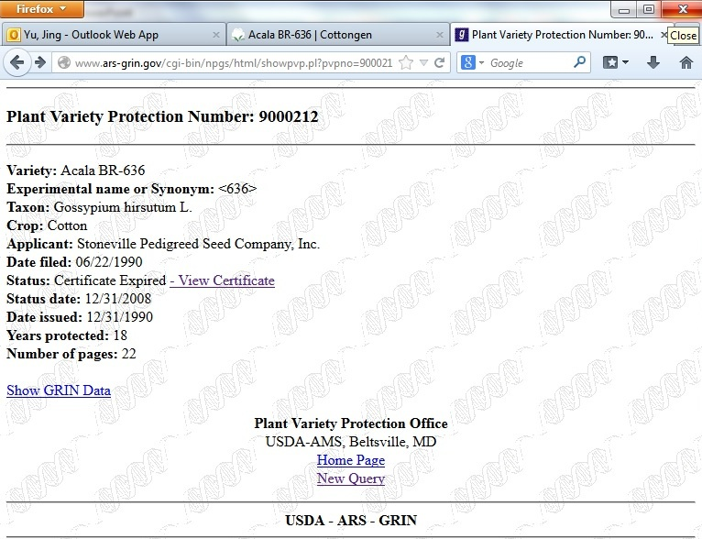
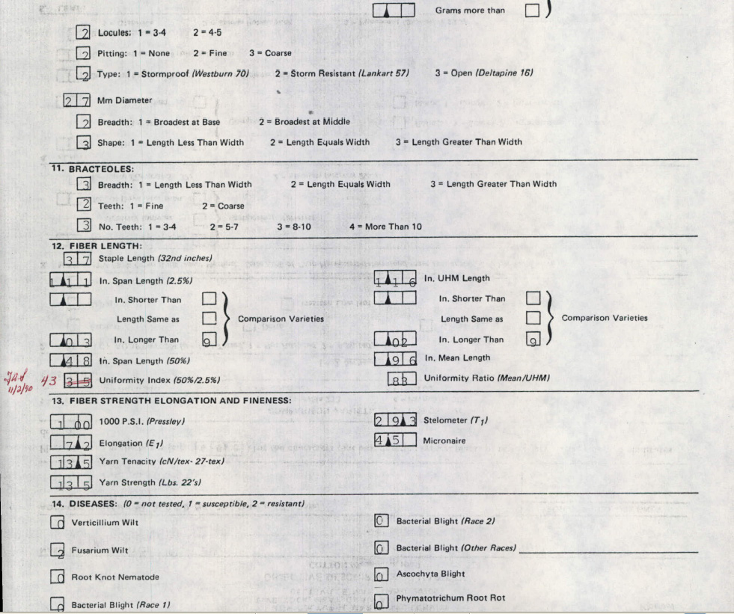
Find out more information by clicks

Slide 21
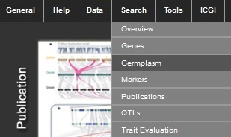
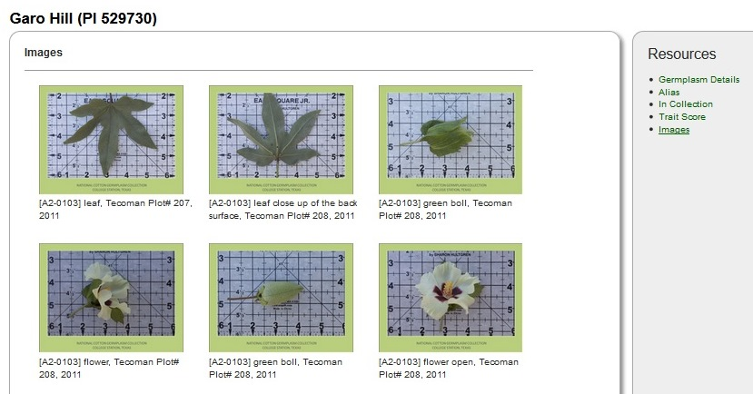
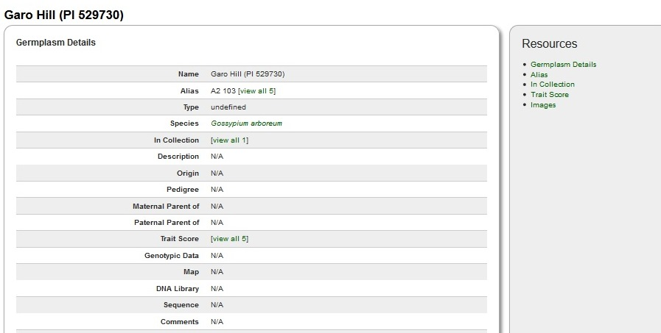
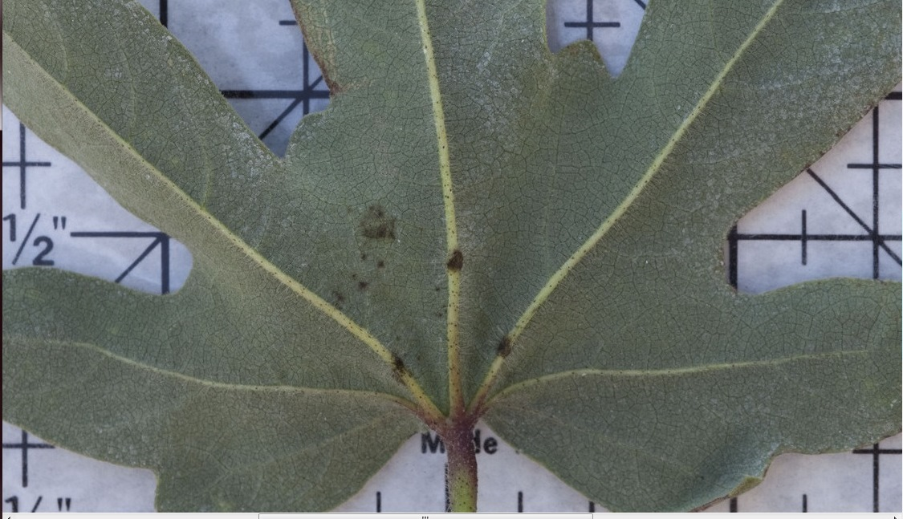
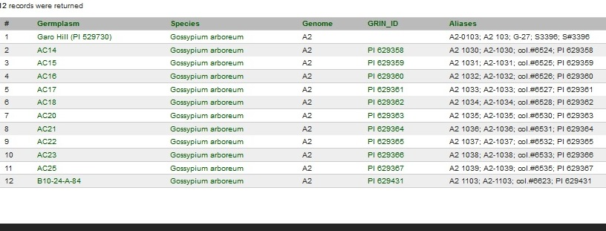
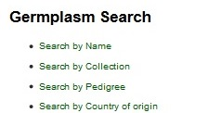
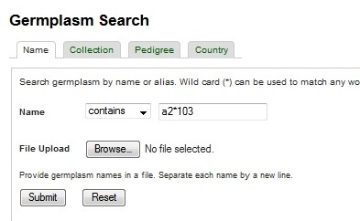
Germplasm Images
How can I find images for ‘A2 103’?

Slide 22
Future Work
2nd set of digital images from ARS College Station, TX
New germplasm evaluation data from ARS College Station, TX
Implement GenSAS, a genome annotation community annotation tool.
Implement GBrowse-Syn, a GBrowse-based synteny browser to view multiple sequence alignment data, synteny or co-linearity data from closely related or useful species such as cacao and Arabidopsis

Slide 23
Acknowledgements
Industry Funding
Cotton Incorporated, Bayer CropScience, Dow/Phytogen, Monsanto, Association of Agricultural Experiment Station Directors
Government Funding
USDA ARS
USDA NIFA AFRI and SCRI programs (funding Mainlab Tripal and GenSAS Development)
University Support
Washington State University, Texas A&M, Clemson University
Community of Cotton Researchers

Slide 24
THANKS FOR YOUR ATTENTION!
Questions?

